Slide 1

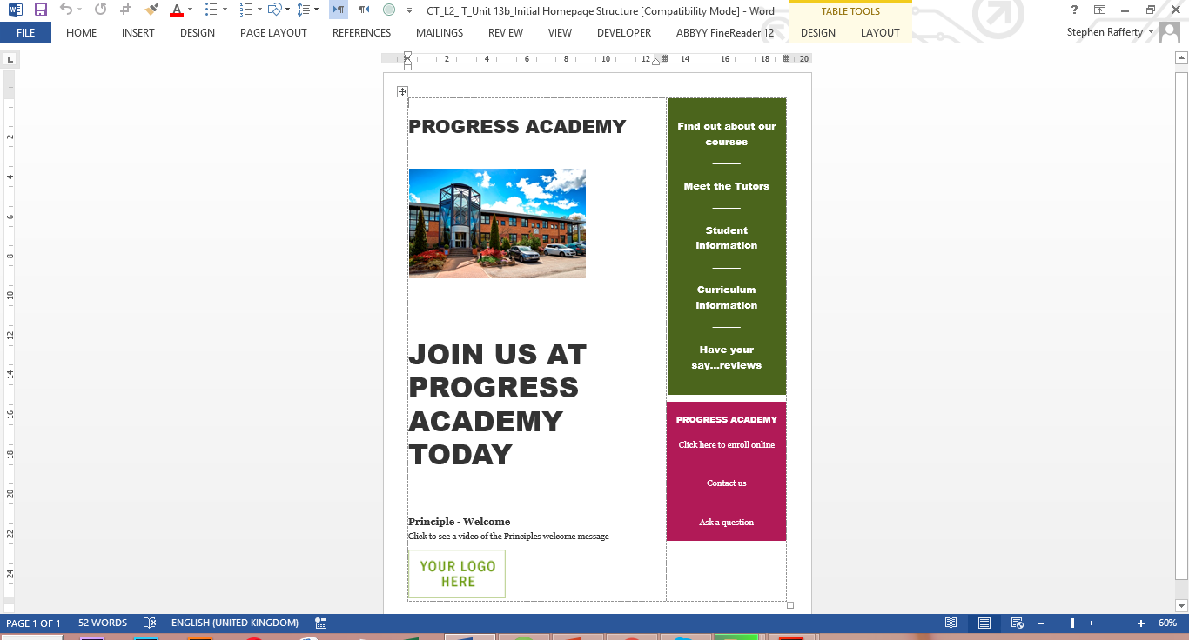
OCR Level 02 – Cambridge Technical
Unit 13 – Creating Websites
2016 Specification - T/615/1382
LO2 - Be able to review existing websites in relation to business needs

Slide 2
Assessment Criteria
The Learner will | Pass The assessment criteria are the pass requirements for this unit. The learner can: | Merit To achieve a merit the evidence must show that, in addition to the pass criteria, the learner is able to: | Distinction To achieve a distinction the evidence must show that, in addition to the pass and merit criteria, the learner is able to:
1 - Know how websites are used by organisations | P1 - Describe the uses of websites in organisations
2 - Be able to review existing websites in relation to business needs | P2 - Review an existing website used for a specified business need | M1 - Be able to review existing websites in relation to business needs
 | P3 - Prepare a plan for realising improvements or enhancements to the specified website
3 - Be able to create or modify components of websites to meet business needs | P4 - Create or modify website components | M2 - Present website components to stakeholders for approval | D1 - Recommend changes to website components based on stakeholder feedback
4 - Be able to update websites to meet business needs | P5 - Update website with developed or modified components | M3 - Test functionality of updated website and resolve any issues
 | P6 - Present updated website to stakeholders |  | D2 - Evaluate the updated website against the needs of the business

Slide 3
Aim and Purpose
e
Learning Outcome 2: Be able to review existing websites in relation to business needs
Your task is to: identify potential improvements, modifications or extensions to the current Progress Academy homepage and plan the implementation of these changes.
The IT Manager at Progress Academy has designed an initial homepage structure for the proposed website that will eventually be used by the Progress Academy staff.
You have been asked to identify improvements, modifications or extensions to the homepage that will improve functionality and meet the business needs of Progress Academy. You will need to refer to the website specification when considering each improvement or extension. You will provide specifications for each identified improvement or extension.
You have also been asked by the SMT to plan the implementation of your identified improvements and/or extensions including the subsequent upgrading of the original website.

Slide 4
Assessment Criterion P1
P2.1 - Review existing websites, i.e.:
target audience
purpose
aesthetics (e.g. content)
legal requirements
user needs (e.g. download speed, functionality)
security features
multimedia
interactivity
accessibility
P2.2 - Improvements or enhancements to websites, i.e.:
content
design
structure
functions
P3.1 - Prepare a plan, i.e.:
planning (e.g. storyboards, site maps, navigation maps, mind maps, sample page visualisations)
style (e.g. layout, images, format, house style)
designs for components (e.g. text, images, buttons, navigation bar)
interactive features (e.g. hyperlinks, voting buttons, email)
timescale
resources (i.e. physical and human)
M1.1 - Specify improvements or enhancements to the reviewed website
What makes a good website Offline vs online web creation Do people still use HTML to write websites Are all websites made the same way Can I make a website as good as Amazon How many pages does a website need to have What is HTML5.

Slide 5
Assessment Criterion P2, M1, P3
LO2 Be able to review existing websites in relation to business needs
This learning outcome is about the learners reviewing an existing website to see how it meets a specified business’s needs. Learners will need to specify ways in which the website could be improved or enhanced to support development of the business. It is important that the specified business needs for the website allow learners to create or modify components, and to specify improvements and enhancements.
P2: Learners are required to review an existing website currently used by a business against the revised business needs. Evidence could be in the form of a report, annotated printouts from website, presentation or recording of the presentation being delivered to an audience.
M1: Learners must specify improvements or enhancements to the reviewed website to meet the revised business needs. Evidence could be in the form of a report, presentation or a recording of a presentation or a meeting where the improvements or enhancements are explained by the learner.
P3: Learners should prepare a plan for realising the improvements or enhancements to the specified website based on the business needs identified in P2. Evidence must be planning documentation which includes timescales and sketches or electronic diagrams for the creation or modification of components.
What makes a good website Where should links be on a website Does having sound on a web page help Does design matter is the content is good How many click should it take to get to a place How long does it take you to move off the homepage What are frames.

Slide 6
P2.1 – Review Existing Websites – Purpose and Audience
P2.1 - Review existing websites, i.e.:
The IT Manager at Progress Academy has designed an initial homepage structure for the proposed website that will eventually be used by the Progress Academy staff.
The website is in the early stages but the IT manager wants you to first review the current needs and structure of the proposed site to specify the users needs, features and whether the current design meets those needs.
This needs to be broken down into a report or a presentation with evidence from the current website design. Click here.
You should be critical in your judgement of what is good and bad about the site as you will be adapting what they have and improving on the layout. Marks are awarded for your ability to identify and improve the way the site looks, acts and appeals to the target audience.

Slide 7
P2.1 – Review Existing Websites – Purpose and Audience
Target audience – This is a website that is aimed at two different audiences, students and the parents of students. Both of these will have a different need from the site. In a report or presentation outline the current needs of this website (use your own school website as an example) of what both these audience will require from the website and how they should go about getting it.
Purpose – School websites are there for students to access materials internally and parents to view externally. They should be promotional as well as functional and give access for parents to all the necessary information they may need to make a decision on whether to send their children there.
Think about what you would want your parents to be able to access on the school website and in your review, look at your own school site and see what the school has decided your parents need to be able to access.
P2.1 – Task 01 - Using the Progress Academy home page, describe, with examples, the company needs and how the site meets or does not meet the purpose and audience of the school.

Slide 8
P2.1 – Review Existing Websites – Aesthetics and Legality
Aesthetics (e.g. content) – All websites need content to make them interesting or useful. Too much information and the user and the user will find it difficult to read, too little and they will find it unprofessional. Links to content, size of text, location and quality of images, number of links etc. all have an impact on the look and feel of the website.
In your write up discuss these and other issues such as white space, text size and structure.
Legal requirements – there are different issues that need to be taken into consideration when setting up a site, copyright, data protection, child protection and data security. All these need to be considered when preparing the content.
In your review of the current page, describe what may need to be restricted. For example, the image of the school will be legal if the school took the image, but not if the image was not owned legally by the school.
P2.1 – Task 02 - Using the Progress Academy home page, describe, with examples, the company needs and how the site meets or does not meet the purpose and audience of the school.

Slide 9
P2.1 – Review Existing Websites – User Needs & Security
User needs (e.g. download speed, functionality) – What the students, teachers and parents require from the website are different. Download speed is one thing that is important but so too is the functionality of the site, serving its purpose, to demonstrate the image of the school as well as to present the appropriate information to the students and parents.
When you describe the website, describe what you think the needs are in reality, do they need a presentation of the school or to be functional, documents to be downloaded, reports to read etc.
Security features – With the different users, there may be a requirement for different levels of access to a website, parental, teacher and student access. The website needs to have a function for this if this feature is included, it also needs to have protections for payments if it has any link to school payments.
In your review of the current page, describe the users actual needs and what may need to be restricted or made secure. For example, if the school incorporates school pay for student meals from the website, will it need https:// added.
P2.1 – Task 03 - Using the Progress Academy home page, describe, with examples, the company needs and how the site meets or does not meet the User Needs and Security Features of the school.

Slide 10
P2.1 – Review Existing Websites – Multimedia, Interactivity and Accessibility
Multimedia – Multimedia content includes text, images, videos, animations and other content. For a school some of this is necessary, For a school this will contain the obvious needs, building to help parents find it, map and images of students being happy or the classes. But additional content is usually added to make the website more entertaining for students and parents.
Interactivity – For a school website to be useful, content on the site needs to be usable as well as functional, forms, school pay, galleries, links to the VLE etc. From your own school website, describe what this one needs to make it a good school portal.
Accessibility – Website need to meet the needs of the target audience in terms of readability, usability, W3C compliance etc. For some websites most of this is not necessary but for a school there are considerations to be taken.
For example, not all students may be capable of reading English as well as their own language, there may be eye sight issues with parents, the website needs to be mobile compatible, there may be technical issues such as flash installed etc.
P2.1 – Task 04 - Using the Progress Academy home page, describe, with examples, the company needs and how the site meets or does not meet the Multimedia, Interactivity and Accessibility needs of the school.

Slide 11
M1.1 – Improvements or enhancements to websites
For M1.1 you need to describe based on your previous review, what you would change about the current plans for the Progress Academy Webpage to make it better.
This needs to be done with an explanation as to why these changes would improve the look, functionality and usability of the site. You need to use the following headings:
  Content – based on your own school, what content would you include on the home page of the site and what content would you feel would be better on sub pages. For each change you should describe how, where and the improvement, enhancement it would make.
  Design – How would you lay out the pages, how many columns, colours, quality and number of images, header and footer and how would these improve the functionality of the school website.

Slide 12
M1.1 – Improvements or enhancements to websites
  Structure – How would you change the layout, and location of the content, where would you prefer to put the navigation buttons or menu, suggest locations for all other forms of navigation on the website.
  Functions – How and where would you place the additional content that school websites have, such as galleries etc., are they important enough to be on the homepage or better on sub pages, should there be direct links.
  And documents, PDF’s or Word, what type should they be, where should they be and how does all this add to the functionality of the website.
  M1.1 – Task 05 – In terms of Content, Design, Structure and Functions, specify improvements or enhancements to the website.
  For this you will need to create a report or a presentation outlining these enhancements or improvements, with evidence of how and where and be specific on how these enhancements would improve the functionality of the website.

Slide 13
P3.1 – Prepare a plan for realising improvements
For P3 you will need to plan a website based on the design and on your findings and arguments in P2 and M1. For this you will need to explain and create a series of planned document that needs to take into consideration the following functions:
  planning documents e.g. storyboards, navigation maps and visualisations;
  annotated diagrams/sketches and house style;
  specifications for the proposed improvements/extensions;
  security features;
  timescales;
  clear links to the identified business need and specification;
  legal requirements to be considered.
Evidence must be planning documentation which includes timescales and sketches or electronic diagrams for the creation or modification of components.
These can be created into a report or a presentation if so, the presentation must contain speaker notes.

Slide 14
P3.1 – Prepare a plan for realising improvements – Site Map
P3.1 – Task 06 - Create a Site Map for your website design. For each page you need to describe its purpose and what it will contain to meet that purpose and how these improvements will enhance the website.
REMEMBER: You will need at least 5 pages
1 - Home /
about
2- Accessibility
options
3 - DVD’s
4 - Computer
Games
5 - Customer
Feedback
6 - How to
order

Slide 15
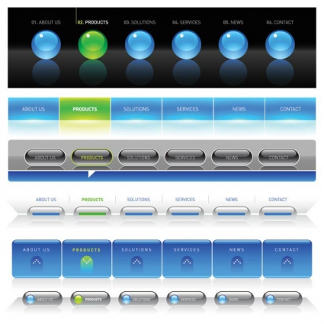
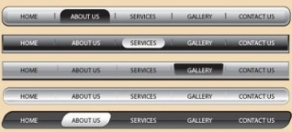
P3.2 – Prepare a plan for realising improvements – Navigation Bar
P3.2 – Task 07 – Design, Illustrate and explain choice of navigation bars for your website in line with the clients needs.
  This should be generic enough so that all of your pages can follow it
  You need to detail everything that will
  be consistent on all pages, fonts,
  size, colours, background colours,
  accessibility options, site map,
  location of navigation system, logo,
  additional or external links.
Navigation Bar
Headings = Times new roman size 24
Subheading = Times new roman size 20
Text = Times new roman size 14
All Text colour = black
Page colour = White

Slide 16
P3.3 – Prepare a plan for realising improvements – House style
P3.3 – Task 08 - Illustrate and explain the house style for your website in line with your client’s specifications.
  This should be generic enough so that all of your pages can follow it
  You need to detail everything
  that will be consistent on all
  pages, fonts, sizes, colours,
  background colours,
  accessibility options, site map,
  location of navigation system,
  logo, additional or external links.
Background Colour will be ?
LOGO
Heading, FSC
Links
Subheading, FSC
Link to ?
Multimedia component
Text, FSC
Text,, FSC
Link to ?
Multimedia component
Text, FSC
Text, FSC
House Style
Headings = Times new roman size 24
Subheading = Times new roman size 20
Text = Times new roman size 14
All Text colour = black
Page colour = White
Link to ?
Text, FSC
Text, FSC
Multimedia component
Link to ?
Email links
External link , FSC
This example just for illustrative purposes and is not complete

Slide 17
P3.4 – Prepare a plan for realising improvements – Page Structure
P3.4 – Task 09 – Design a page plan based on your House style indicating the major content and functionality of your website in line with the clients specifications.
You need to plan for the inclusion of at least three forms of Multimedia or Interactive Content on your website to make it more audience friendly.
Some examples include:
  Login and User Account option
  Responsive design option
  Web form
  Map
  Hyperlinks, voting buttons, email
  Image rollovers or gallery
  Embedded videos or sounds
  Alt tags which describe multimedia content that may not appear on certain devices used to access the Internet
Why are all web pages starting to look the same Do I have to learn programming to be a web developer How much does making and having a website cost How do I get up the rankings in Google What are the limits of HTML coding Web accessibility and colour schemes How will VR and Web integrate

Slide 18
P3.5 – Prepare a plan for realising improvements– Page Structure
These page plans need to be detailed to a degree and indicate where the content will be placed. These will be measured to a degree against your finished pages but do not need to be so accurate that they exactly match
  You will need to explain how each page will look and what it will contain
  It should be detailed enough so that a third party could implement your designs in your absence.
All links are flash buttons – blue warper
LOGO
Page Information
Links internal = Home, CDs, DVDs, Order.
Links External = Metacritic.com, www.google.com
Accessibility features = Alt tags, altered text size / background colour.
Meta tags = computer games Wii, Xbox, PC
The Digital Realm
Links
Computer Games
Home
Image of World of Warcraft box art
Description of game
Price and availability
This example just for illustrative purposes and is not complete
Accessibility
Image of Wii Sports Resort box art
Description of game
Price and availability
DVD’s
Image of Gears of War 2 box art
Description of game
Price and availability
Order
Email link to sales
Email link to customer service
External link to Google
External link to metacritic

Slide 19
P3.5 – Produce a Plan for an Client Based Website
P3.5 – Task 10 – Explain the additional content on your webpage and how they meet the clients specifications.
Design (e.g. font, colour)
Interactive elements to meet the client’s needs
Responsive design
For different devices, e.g. tablet, phone, PC
For different browsers, e.g. IE, Chrome, Safari
For this you need to indicate how you have considered the above elements for your client. This could be in the form of a button, link or simply an explanation of how you intend on taking these into consideration.
For example, different browsers, you can explain how you will run the completed website through the validation sites named in LO1, to verify use on the browsers. Also you can explain that you can test them on the installed school browsers and verify the links, the scaling and the image quality.
For different devices explain how you can upload them to a testing site or to your own intranet site for testing on a mobile device to allow you to rescale, adapt or replace content.
Why are all web pages starting to look the same Do I have to learn programming to be a web developer How much does making and having a website cost How do I get up the rankings in Google What are the limits of HTML coding Web accessibility and colour schemes How will VR and Web integrate

Slide 20
P3.6 – Produce a Plan for an Interactive Website
P3.6 – Task 11 – In a report, describe how improvements on the website will include the following features and the benefit of these.
Security features – how and where the security restrictions should be, location, type and features of these.
Timescales – describe how long it should take to create the website, based on a school calendar year, when should the changeover features be in place and how long the trial or inclusion period be. Draw up a time plan for this.
Clear links to the identified business need and specification – describe the linking processes needed to make the website functional as well as in line with the school colour schemes.
Legal requirements to be considered – describe how you will go about making the website secure including testing and protecting for copyright.
Resources (i.e. physical and human) – Describe who at the school should make the website, how they should do this, the resources in terms of hardware and software needed to achieve this. Talk about storage and capacity for expansion to meet the clients present and future needs.
Why are all web pages starting to look the same Do I have to learn programming to be a web developer How much does making and having a website cost How do I get up the rankings in Google What are the limits of HTML coding Web accessibility and colour schemes How will VR and Web integrate

Slide 21
LO2 – Assessment Criteria
P2.1 – Task 01 - Using the Progress Academy home page, describe, with examples, the company needs and how the site meets or does not meet the purpose and audience of the school.
P2.1 – Task 02 - Using the Progress Academy home page, describe, with examples, the company needs and how the site meets or does not meet the purpose and audience of the school.
P2.1 – Task 03 - Using the Progress Academy home page, describe, with examples, the company needs and how the site meets or does not meet the User Needs and Security Features of the school.
P2.1 – Task 04 - Using the Progress Academy home page, describe, with examples, the company needs and how the site meets or does not meet the Multimedia, Interactivity and Accessibility needs of the school.
M1.1 – Task 05 – In terms of Content, Design, Structure and Functions, specify improvements or enhancements to the website.
P3.1 – Task 06 - Create a Site Map for your website design. For each page you need to describe its purpose and what it will contain to meet that purpose and how these improvements will enhance the website.
P3.2 – Task 07 – Design, Illustrate and explain choice of navigation bars for your website in line with the clients needs.
P3.3 – Task 08 - Illustrate and explain the house style for your website in line with your client’s specifications.
P3.4 – Task 09 – Design a page plan based on your House style indicating the major content and functionality of your website in line with the clients specifications.
P3.5 – Task 10 – Explain the additional content on your webpage and how they meet the clients specifications.
P3.6 – Task 11 – In a report, describe how improvements on the website will include the following features and the benefit of these.

